Slide 1
Start Smart
Switch Sooner
Presenter Name
Hospital Name

Slide 2
Purpose:
Summarize national trends in supply and hospital utilization of O negative red blood cells
Examine O negative overuse as a contributor to O negative shortages
Review industry guidance on use of Group O red blood cells
Discuss strategies to reduce overutilization of O negative red blood cells
2

Slide 3
Rationale for Change
Industry level data reveals O negative Red Blood Cells are in chronic short supply and have not been at optimal levels since 2021. The supply challenges are further intensified by a declining donor base and changing donor demographics. Looking forward, this trajectory is unsustainable.
Hospitals and blood providers must act now to ensure product availability for patients who need it most.
Notes:
This graph from AABB shows the national Group O blood supply, this data is obtained from ARC plus other large blood collectors.
The orange line represents National O negative inventory, which runs near critical low levels much of the time.
O negative supplies have not experienced optimal levels since 2021, an anomaly associated with strong donor turnout during the pandemic
Instead, O negative red cells are in chronic short supply, resulting in instability, operational burden for blood centers and healthcare providers and patients potentially lacking the blood they require. Action is required.

Slide 4
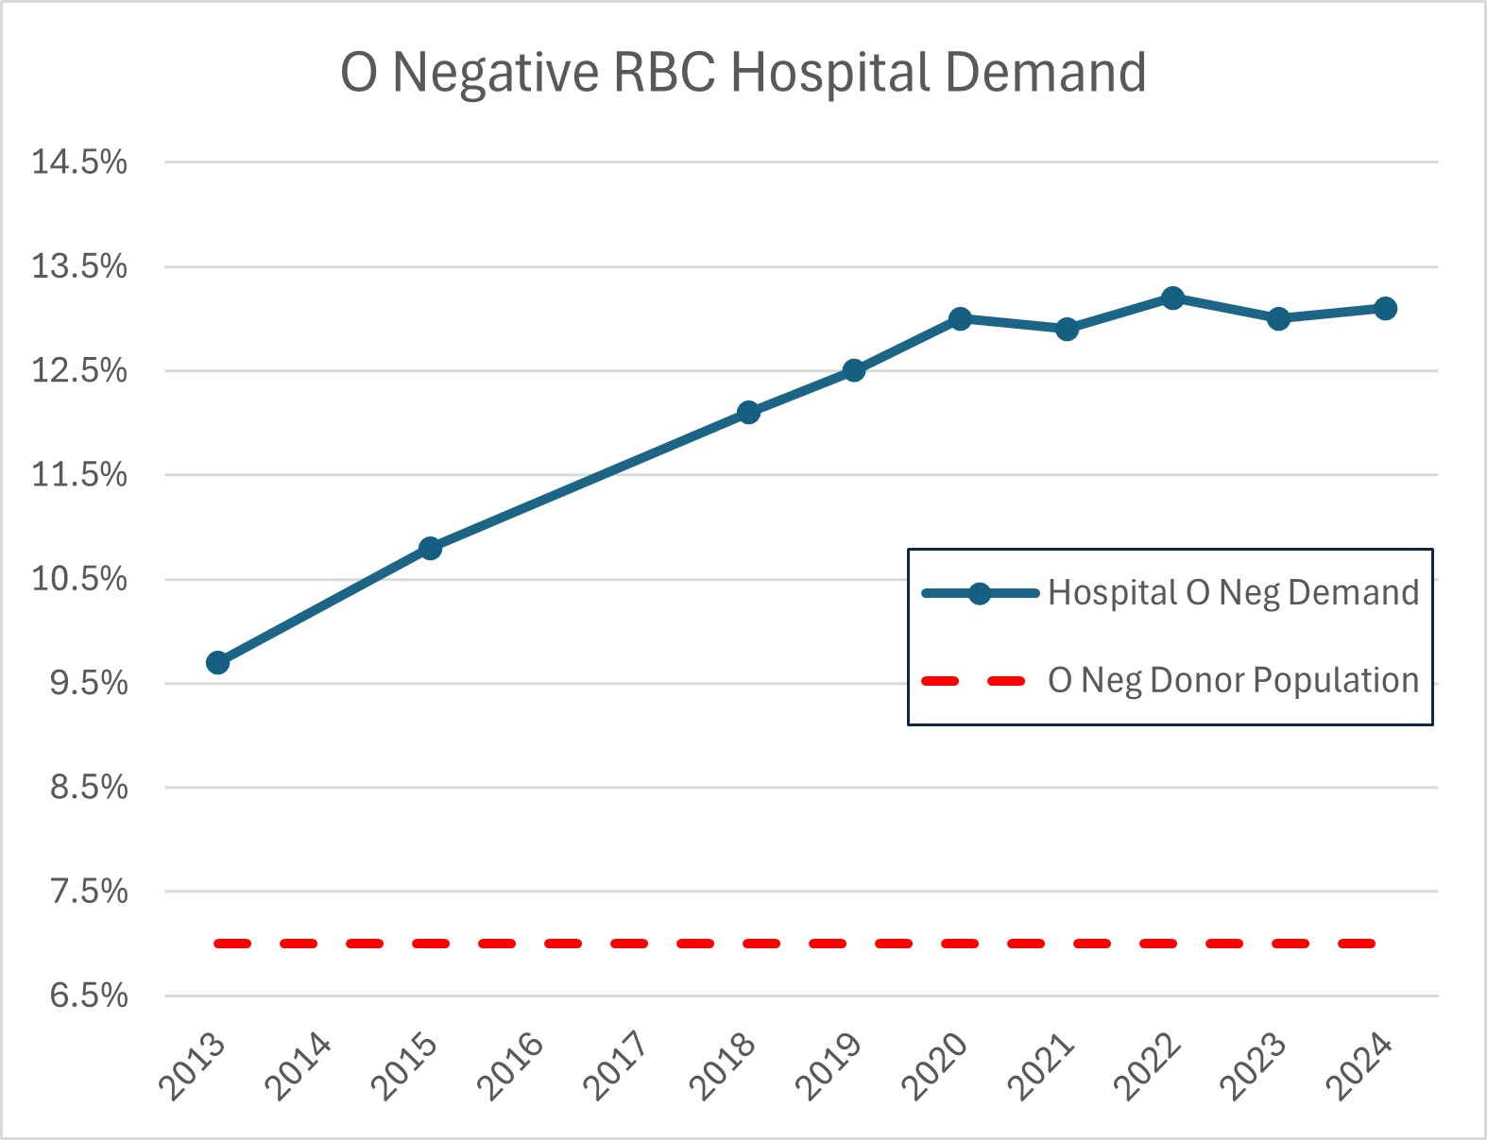
Red Cross O Negative Hospital Demand Steadily Increasing Over the Past Decade
Avg O negative patient population is 6.9%
12-month O negative distributions are 13.2%
Resulting in near constant O negative shortage
Notes:
Distributions to hospitals have been steadily increasing for the past decade. In the last quarter of 2024, ARC averaged 13.5% O neg distributions!!!
But remember that only 6.9% of donors are O negative blood type.
As hospitals stock fewer blood products, they have increasingly relied on O negative units, which is the universal blood type, out of convenience and cost avoidance.
This high hospital demand, at nearly double the rate of the donor and patient population, causes O neg inventory to remain near critical low despite robust blood collections!

Slide 5
Examining O Negative Overuse
Recent studies indicate a shortage of O negative blood product, stems from significant overuse when the type was not required for transfusion.
43.2%
GROUP Study¹: 43.2% O negative units given to non-O negative recipients.
GROUP Study attributes top reasons for overuse to:
emergency transfusion
unit near expiration
meet antigen negative requirement
67%
Stanford Study²: 67% O negative units transfused to non-O negative recipients.
Optimus Study³: 44.5% O negative transfusions could have used O positive.
44.5%
Zeller MP, Barty R, Aandahl A, et al. An international investigation into O red blood cell unit administration in hospitals: the Group O Utilization Patterns (GROUP) study. Transfusion2017;57:2329-37
Virk MS, et al. Optimizing O-negative RBC utilization using a data-driven approach. Transfusion. 60:4. Apr 2020: 739-746.
Dunbar NM, Yazer MH, for the BEST Collaborative. O– product transfusion, inventory management, and utilization during shortage: The OPTIMUS study. Transfusion 2018;58: 1348-55.
Notes:
These three studies demonstrate there is likely significant overutilization of O negative red blood cells by hospitals. Some of the most common sources of O neg overutilization are transfusion of O neg during emergencies (even to males and females beyond childbearing potential) and units that are near expiration are given to non-O negative patients for routine transfusions so that they are not “wasted”. These may be two areas to focus on when looking for ways to reduce O negative utilization rates.
Note: Using O negative units to meet antigen negative requirements for non-O negative patients is another potential source of overutilization The Red Cross is investing to create a more diverse donor pool and to recruit and retain Black/African American and Latino blood donors. By diversifying the donor population and ordering type specific antigen negative units, we can better meet our patients with sickle cell disease needs and preserve O negative units for the patients that need them most.

Slide 6
Examining O Negative Overuse
O negative red blood cells are in chronic short supply and must be reserved for O negative patients.
Less than 7% of the population is O negative and declining as the U.S. population becomes increasingly more diverse.
The demand for O negative blood is nearly double the patient population, driven by convenience and cost avoidance rather than clinical need.
Notes:
GROUP study
43.2% of O neg units given to non-O neg recipients
Top 3 reasons: emergency transfusion, unit near expiration, meet antigen negative requirement
Stanford experience
67% O neg units transfused to non-O neg recipients,
O neg units at end of shelf life more likely to be transfused to non-O neg patients to prevent wastage
OPTIMUS study
44.5% O neg transfusions could have used O pos

Slide 7
Start Smart Switch Sooner

Slide 8
Choose Wisely Campaign
The American Board of Internal Medicine’s Choosing Wisely campaign incorporated AABB recommendations on O negative use. The campaign was designed to help physicians and patients engage in conversations to reduce the overuse of tests and procedures.
https://www.aabb.org/docs/default-source/default-document-library/resources/choosing-wisely-five-things-physicians-and-patients-should-question.pdf

Slide 9
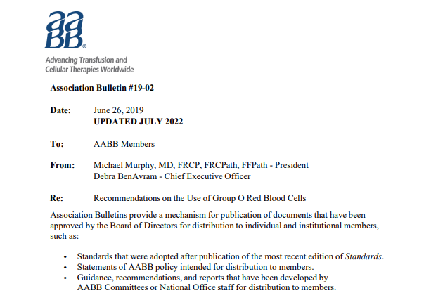
AABB Best Practice Guidelines
https://www.aabb.org/docs/default-source/default-document-library/resources/association-bulletins/ab19-02.pdf
Notes:
The AABB Association Bulletin on Recommendations for the use of group O red blood cells is an excellent resource that provides actionable and evidence-based recommendations for both hospitals and blood collectors to help stabilize the group O negative supply. This document calls out the need for blood collectors to share education on O negative stewardship with hospitals.
It’s our collective obligation to act now to ensure O negative availability for patients who require O negative red cells.

Slide 10
AABB Recommendation for Group O Use
Provide ABO/Rh type-specific units whenever possible.*
*https://www.aabb.org/docs/default-source/default-document-library/resources/association-bulletins/ab19-02.pdf

Slide 11
AABB Recommendation for Group O Use
Group O Rh(D)-negative RBCs should be reserved for three cohorts of females of childbearing potential: those who are group O Rh(D)-negative, those who are Rh(D)-negative requiring transfusion when type-specific blood is unavailable, and those of unknown blood type who require RBCs before the completion of pretransfusion testing.*
*https://www.aabb.org/docs/default-source/default-document-library/resources/association-bulletins/ab19-02.pdf

Slide 12
O Negative Tip: Start Smart
Type specific units should be provided whenever possible.²
O negative RBCs should be saved for O negative patients, and in emergencies for women of childbearing potential when blood type is unknown.^{1,2}
During emergencies when blood type is unknown, adult males and women beyond childbearing potential should be transfused with O positive RBCs and switched to type-specific as soon as possible.^{1,2}
Establish a policy defining when to use O positive RBCs during emergency transfusions in patients with unknown blood type.
https://www.aabb.org/docs/default-source/default-document-library/resources/choosing-wisely-five-things-physicians-and-patients-should-question.pdf
https://www.aabb.org/docs/default-source/default-document-library/resources/association-bulletins/ab19-02-revised.pdf
Dunbar NM, Yazer MH, for the BEST Collaborative. O– product transfusion, inventory management, and utilization during shortage: The OPTIMUS study. Transfusion 2018;58: 1348-55.

Slide 13
AABB Recommendation for Group O Use
Hospital transfusion services should closely monitor utilization of group O, Rh(D)- negative inventory, particularly during bleeding emergencies and during group O Rh(D)- negative shortages. Policies should be developed that describe when patients should be switched to Rh(D)-positive RBCs to avoid depletion of the group O Rh(D)- negative supply.*
*https://www.aabb.org/docs/default-source/default-document-library/resources/association-bulletins/ab19-02.pdf
Notes:
Benchmark data are not widely available to guide hospitals in what is appropriate group O Rh(D)-negative usage. Therefore, hospitals should conduct periodic audits of group O blood use to better understand their utilization patterns and develop policies for appropriate usage.

Slide 14
AABB Recommendation for Group O Use
Hospitals should have protocols to expedite sample collection to quickly switch patients to type-specific blood upon completion of pretransfusion testing. *
*https://www.aabb.org/docs/default-source/default-document-library/resources/association-bulletins/ab19-02.pdf
Notes:
Patients should be switched to type-specific RBCs as soon as pretransfusion testing is completed and compatible blood is available. Verification of the patient's ABO type requires either a second specimen drawn at the current visit or, if available, comparison of the current testing result with blood bank records. Alternatively, some institutions use electronic patient verification to eliminate the need to test a second separately drawn specimen to confirm the recipient blood type.

Slide 15
4
AABB Recommendation for Group O Use
Hospital transfusion services should have a policy for the use of Rh-positive-red-cell containing components in Rh-negative recipients including during times of critical inventory levels. *
*https://www.aabb.org/docs/default-source/default-document-library/resources/association-bulletins/ab19-02.pdf

Slide 16
O Negative Tip: Switch Sooner
Establish a policy describing when to switch O negative patients to Rh positive red blood cells to avoid depleting group O negative inventory.
During an emergency, a single patient can rapidly deplete O negative RBC inventory, potentially jeopardizing O negative availability for your other O negative patients and O negative patients at other hospitals near you.
You can help protect the O negative blood supply by implementing policies describing when to switch patients to Rh pos and ensuring your blood bank team is familiar with them.
Having clear policies in place before an emergency happens can help to prevent a critically low O negative inventory.
Establish a policy to expedite sample collection to quickly switch patients to type-specific blood upon completion of pretransfusion testing.
AABB Recommendations for Appropriate Group O Use: (https://www.aabb.org/docs/default-source/default-document-library/resources/association-bulletins/ab19-02.pdf)

Slide 17
Facts in Review
O negative population in the U.S is 6.9% and declining
Fewer people donate blood today than in the past
An estimated 85% of all hospital patients are Rh positive
Most trauma patients are male
Less than 5% of patients with Sickle Cell disease are O negative
As most patients are Rh positive, the overall risk of anti-D alloimmunization is 3 – 6% when using O positive for emergencies
A transfusion should never be withheld from a bleeding patient
We must work together to reduce our reliance on O negative blood and safely use O positive blood for emergency transfusions.
Notes:
When reviewing the facts, it is clear must act now to protect the blood supply of the future.
O negative blood is in chronic short supply.
O negative inventory remains low and unstable despite robust collections.
Changing demographics and donor populations will further challenge stable O negative supplies.
Studies indicate O negative shortages stems from significant overuse when O negative blood was not required for transfusion.
Demand for O negative blood continues to rise as it is operationally more convenient, but not medically required.
Patient care, especially for those that require O negative blood is adversely impacted by inconsistencies in supply.
Without action, O negative shortages and their impact on patient care will only worsen.

Slide 18
Additional resources can be found at: RedCrossBlood.org/HPRG

