Slide 1
Safe Choices
Presenter Name
Hospital Name

Slide 2
Purpose:
Summarize national trends in supply and hospital utilization of O negative red blood cells
Examine O negative overuse as a contributor to O negative shortages
Review industry guidance on use of Group O red blood cells
Explain the safety of using O positive units for O negative patients
Discuss strategies to reduce overutilization of O negative red blood cells
2

Slide 3
Rationale for Change
Industry level data reveals O negative Red Blood Cells are in chronic short supply and have not been at optimal levels since 2021. The supply challenges are further intensified by a declining donor base and changing donor demographics. Looking forward, this trajectory is unsustainable.
Hospitals and blood providers must act now to ensure product availability for patients who need it most.
Notes:
This graph from AABB shows the national Group O blood supply, this data is obtained from ARC plus other large blood collectors.
The orange line represents National O negative inventory, which runs near critical low levels much of the time.
O negative supplies have not experienced optimal levels since 2021, an anomaly associated with strong donor turnout during the pandemic
Instead, O negative red cells are in chronic short supply, resulting in instability, operational burden for blood centers and healthcare providers and patients potentially lacking the blood they require. Action is required.

Slide 4
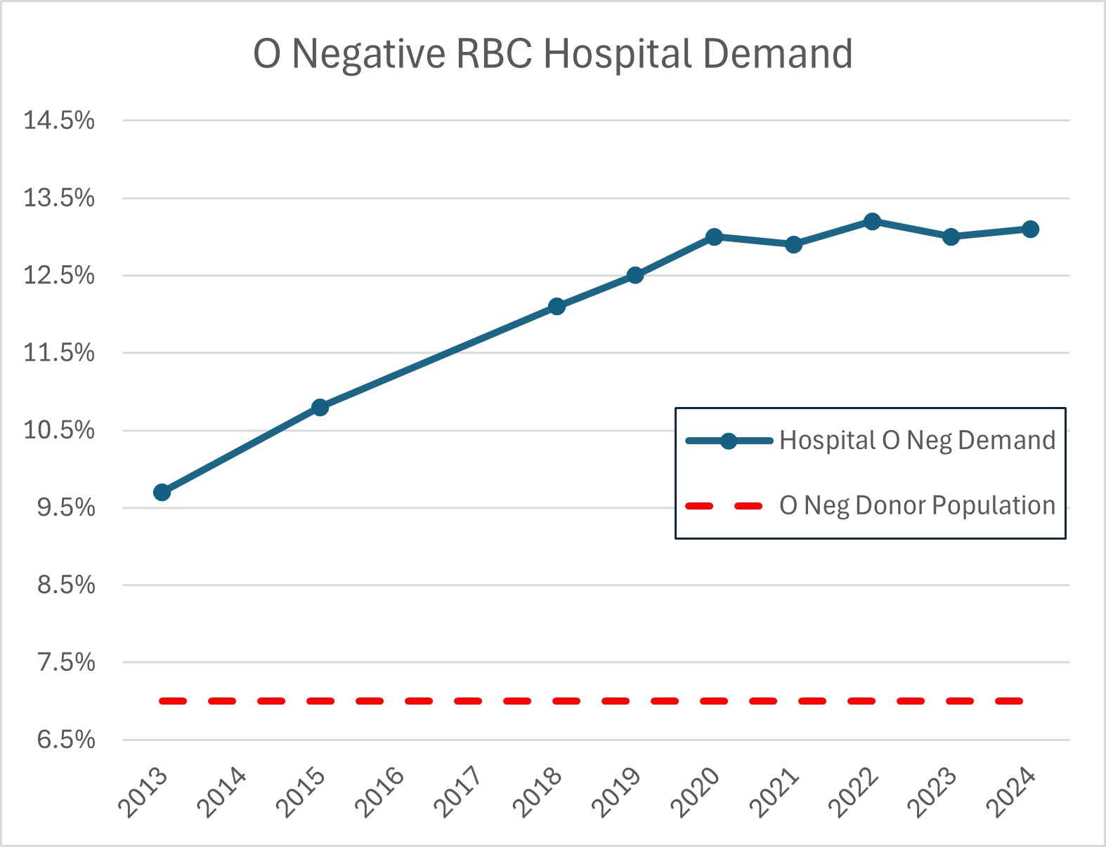
Red Cross O Negative Hospital Demand Steadily Increasing Over the Past Decade
Avg O negative patient population is 6.9%
12-month O negative distributions are 13.2%
Resulting in near constant O negative shortage
Notes:
Distributions to hospitals have been steadily increasing for the past decade. In the last quarter of 2024, ARC averaged 13.5% O neg distributions!!!
But remember that only 6.9% of donors are O negative blood type.
As hospitals stock fewer blood products, they have increasingly relied on O negative units, which is the universal blood type, out of convenience and cost avoidance.
This high hospital demand, at nearly double the rate of the donor and patient population, causes O neg inventory to remain near critical low despite robust blood collections!

Slide 5
Examining O Negative Overuse
Recent studies indicate a shortage of O negative blood product, stems from significant overuse when the type was not required for transfusion.
43.2%
GROUP Study¹: 43.2% O negative units given to non-O negative recipients.
GROUP Study attributes top reasons for overuse to:
emergency transfusion
unit near expiration
meet antigen negative requirement
67%
Stanford Study²: 67% O negative units transfused to non-O negative recipients.
Optimus Study³: 44.5% O negative transfusions could have used O positive.
44.5%
Zeller MP, Barty R, Aandahl A, et al. An international investigation into O red blood cell unit administration in hospitals: the Group O Utilization Patterns (GROUP) study. Transfusion2017;57:2329-37
Virk MS, et al. Optimizing O-negative RBC utilization using a data-driven approach. Transfusion. 60:4. Apr 2020: 739-746.
Dunbar NM, Yazer MH, for the BEST Collaborative. O– product transfusion, inventory management, and utilization during shortage: The OPTIMUS study. Transfusion 2018;58: 1348-55.
Notes:
These three studies demonstrate there is likely significant overutilization of O negative red blood cells by hospitals. Some of the most common sources of O neg overutilization are transfusion of O neg during emergencies (even to males and females beyond childbearing potential) and units that are near expiration are given to non-O negative patients for routine transfusions so that they are not “wasted”. These may be two areas to focus on when looking for ways to reduce O negative utilization rates.
Note: Using O negative units to meet antigen negative requirements for non-O negative patients is another potential source of overutilization The Red Cross is investing to create a more diverse donor pool and to recruit and retain Black/African American and Latino blood donors. By diversifying the donor population and ordering type specific antigen negative units, we can better meet our patients with sickle cell disease needs and preserve O negative units for the patients that need them most.

Slide 6
Examining O Negative Overuse
O negative red blood cells are in chronic short supply and must be reserved for O negative patients.
Less than 7% of the population is O negative and declining as the U.S. population becomes increasingly more diverse
The demand for O negative blood is nearly double the patient population, driven by convenience and cost avoidance rather than clinical need.
Notes:
GROUP study
43.2% of O neg units given to non-O neg recipients
Top 3 reasons: emergency transfusion, unit near expiration, meet antigen negative requirement
Stanford experience
67% O neg units transfused to non-O neg recipients,
O neg units at end of shelf life more likely to be transfused to non-O neg patients to prevent wastage
OPTIMUS study
44.5% O neg transfusions could have used O pos

Slide 7
Safe Choices

Slide 8
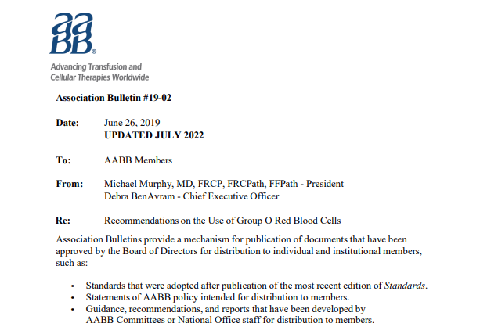
AABB Best Practice Guidelines
Transfuse type-specific, crossmatch-compatible blood whenever possible
Save O negative RBCs for O negative patients and, in an emergency when blood type is unknown, for females of childbearing potential (but switch to type specific as soon as you can!)
https://www.aabb.org/docs/default-source/default-document-library/resources/association-bulletins/ab19-02.pdf
Notes:
The AABB Association Bulletin on Recommendations for the use of group O red blood cells is an excellent resource that provides actionable and evidence-based recommendations for both hospitals and blood collectors to help stabilize the group O negative supply. This document tells us that blood collectors have a responsibility to share education on O neg stewardship with hospitals (it has great info for hospitals as well!)
Transfuse type-specific, crossmatch-compatible blood whenever possible​
Save O negative RBCs for O negative patients and, in an emergency when blood type is unknown, for females of childbearing potential (but switch to type specific as soon as you can!)
Ensure you have policies to define how to start emergency transfusions in patients of unknown blood types with O positive red cells.

Slide 9
Is it safe to use O Positive in an emergency?
Evidence supports that administering Rh positive red blood cells or whole blood in emergencies is low risk.
Alloimmunization is a risk with any transfusion, even with O negative blood
Most patients are Rh positive (85% and increasing)
In the 15% of patients who are Rh negative, risk of anti-D alloimmunization after Rh positive transfusion is 21-26%¹
Risk is even lower (less than 10%) in immunocompromised marrow and solid organ transplant patients¹
Overall risk of anti-D alloimmunization when using O positive for emergencies is between 3% and 6%, as most patients are Rh positive​¹
Evidence supports exposure to greater number of Rh-positive units does not increase alloimmunization risk²​
1. https://www.aabb.org/docs/default-source/default-document-library/resources/association-bulletins/ab19-02.pdf​
2. Seheult JN, et al. Rate of D-alloimmunization in trauma does not depend on the number of RhD-positive units transfused: The BEST collaborative study. Transfusion. 2022;62:S135-S192.
3. Selleng K, et al. Emergency transfusion of patients with unknown blood type with blood group O Rhesus D positive red blood cell concentrates: a prospective, single-centre, observational study. Lancet Haematol. 2017 May;4(5):e218-e224.
​

Slide 10
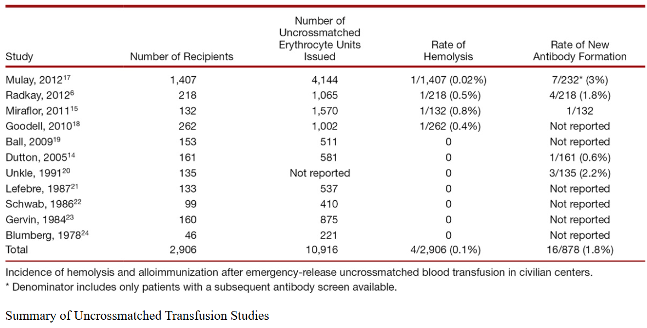
What if the patient already has anti-D?
Risk of non-ABO hemolytic reaction after an emergency uncrossmatched transfusion is very low
Non-ABO hemolytic reactions may occur even with O negative red blood cells (anti-Jka, anti-K, etc.)
IgG anti-D causes extravascular hemolysis, which is usually mild

Slide 11
What about Females of Childbearing Potential?
Addressing concerns for potential risk of Hemolytic Disease of the Fetus and Newborn (HDFN) with future pregnancy
The risk of fatal HDFN after Rh positive transfusion in an RhD negative female of childbearing potential has been estimated to be ~0.3%
Developing policies to follow up and educate Rh negative females of childbearing potential after Rh positive transfusions can help to ensure proper care for future pregnancies
Yazer MH,, et al. It is time to reconsider the risks of transfusing RhD negative females of childbearing potential with RhD positive red blood cells in bleeding emergencies. Transfusion. 2019;59:3794–9.
Malone JR. Ethical considerations in the use of RhD-positive blood products in trauma. Transfusion. 2024;64:S4–S1.
Notes:
A transfusion should never be withheld from a bleeding patient. If group O Rh(D)- negative units are not available for a female of childbearing potential, then the benefit of an emergent Rh(D)-positive blood transfusion must be balanced against the risk of alloimmunization

Slide 12
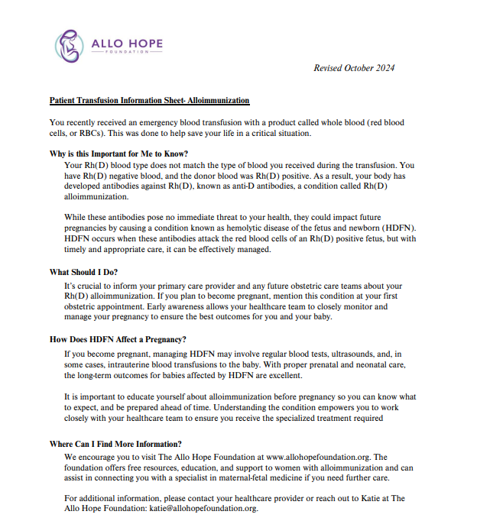
O Negative Tip: Safe Choices
Establish a policy for follow up on Rh negative patients that received a Rh-positive transfusion.
Standard Operating Procedures Include:
When to consider administration of RhIg prophylaxis
Hospital practices vary, must consider potential benefits vs. risk of hemolysis with large doses of RhIg
Plan for follow up patient testing to evaluate for anti-D alloimmunization
Notification and education for patients who become alloimmunized
For females of childbearing potential, patient education letters are available from Allo Hope Foundation
https://allohopefoundation.org/learn/transfusion-medicine/
Lu W, et al. Rh immune globulin immunoprophylaxis after RhD-positive red cell exposure in RhD-negative patients via transfusion: A survey of practices. Transfusion. 2024; 64(5):839-845.

Slide 13
Facts in Review
O negative population in the U.S is 6.9% and declining
Fewer people donate blood today than in the past
An estimated 85% of all hospital patients are Rh positive
Most trauma patients are male
Less than 5% of patients with Sickle Cell disease are O negative
As most patients are Rh positive, the overall risk of anti-D alloimmunization is 3 – 6% when using O positive for emergencies
A transfusion should never be withheld from a bleeding patient
We must work together to reduce our reliance on O negative blood and safely use O positive blood for emergency transfusions.
Notes:
When reviewing the facts, it is clear must act now to protect the blood supply of the future.
O negative blood is in chronic short supply.
O negative inventory remains low and unstable despite robust collections.
Changing demographics and donor populations will further challenge stable O negative supplies.
Studies indicate O negative shortages stems from significant overuse when O negative blood was not required for transfusion.
Demand for O negative blood continues to rise as it is operationally more convenient, but not medically required.
Patient care, especially for those that require O negative blood is adversely impacted by inconsistencies in supply.
Without action, O negative shortages and their impact on patient care will only worsen.

Slide 14
Additional resources can be found at: RedCrossBlood.org/HPRG

