Slide 1
Know Where Your Os Go
Presenter Name
Hospital Name

Slide 2
Purpose:
Summarize national trends in supply and hospital utilization of O negative red blood cells
Examine O negative overuse as a contributor to O negative shortages
Review industry guidance on use of Group O red blood cells
Discuss strategies hospitals can employ to reduce overutilization of O negative red blood cells
2

Slide 3
Rationale for Change
Industry level data reveals O negative Red Blood Cells are in chronic short supply and have not been at optimal levels since 2021. The supply challenges are further intensified by a declining donor base and changing donor demographics. Looking forward, this trajectory is unsustainable.
It’s our collective obligation to act now to ensure product availability for patients who need it most.
Notes:
This graph from AABB shows the national Group O blood supply, this data is obtained from ARC plus other large blood collectors.
The orange line represents National O negative inventory, which runs near critical low levels much of the time.
O negative supplies have not experienced optimal levels since 2021, an anomaly associated with strong donor turnout during the pandemic
Instead, O negative red cells are in chronic short supply, resulting in instability, operational burden for blood centers and healthcare providers and patients potentially lacking the blood they require. Action is required.

Slide 4
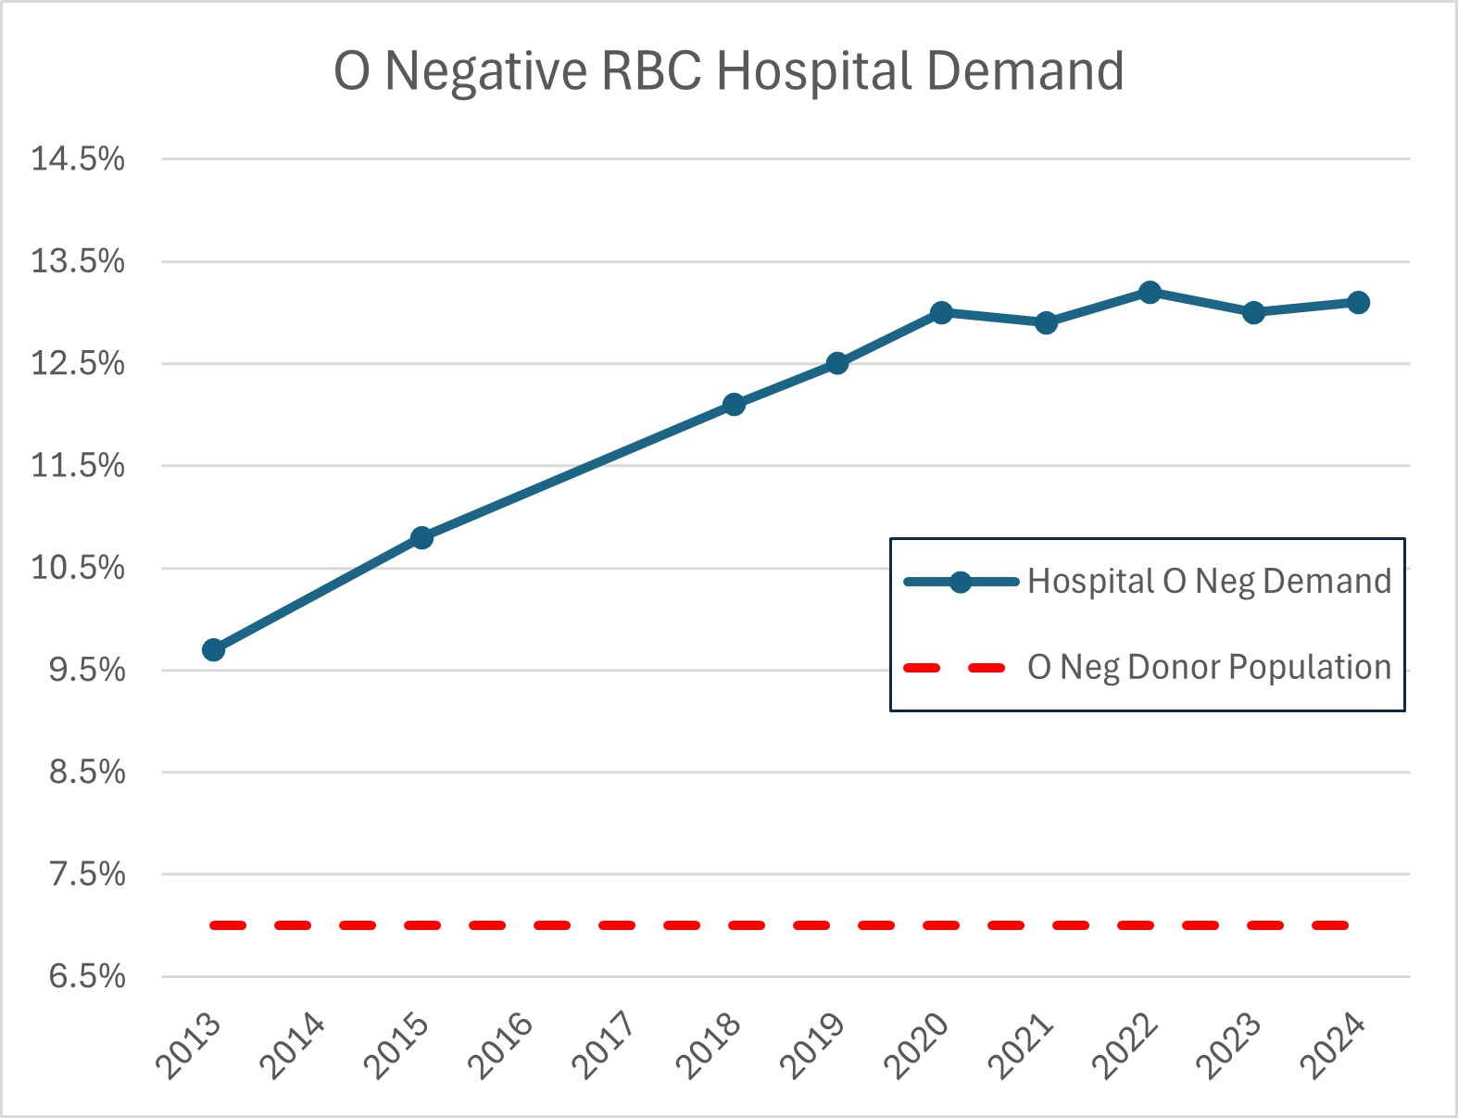
Red Cross O Negative Hospital Demand Steadily Increasing Over the Past Decade
Avg O negative patient population is 6.9%
12-month O negative distributions are 13.2%
Resulting in near constant O negative shortage
Notes:
Distributions to hospitals have been steadily increasing for the past decade. In the last quarter of 2024, ARC averaged 13.5% O neg distributions!!!
But remember that only 6.9% of donors are O negative blood type.
As hospitals stock fewer blood products, they have increasingly relied on O negative units, which is the universal blood type, out of convenience and cost avoidance.
This high hospital demand, at nearly double the rate of the donor and patient population, causes O neg inventory to remain near critical low despite robust blood collections!

Slide 5
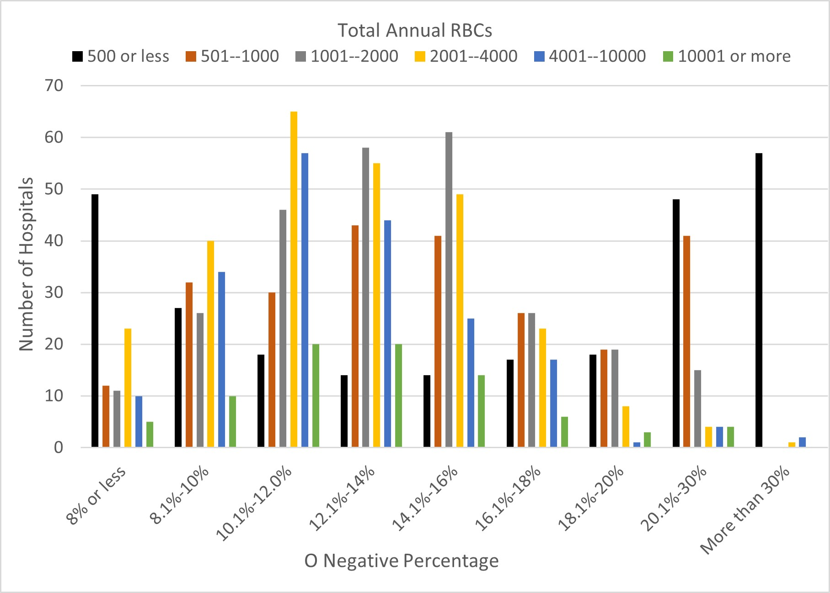
O Negative Distributions
There is significant variation in O negative demand for hospitals of all sizes
Notes:
Our internal data shows that there is significant variation—whether we look at it by hospital size, hospital type (trauma, pediatrics, general hospital, etc.), we always find some hospitals with low O negative utilization rates (less than 8%!), some with high rates (more than 20 or even 30%!), and many in between. Remember the O neg donor base and patients populations average 6-7% O neg type. We have met with many hospitals that have
the lowest O negative rates to better understand their practices, so we can share that information with similar hospitals that have higher rates.
This data would suggest there is opportunity to reduce the overuse of O negative blood. We have met with many hospitals that have the lowest O negative rates to better understand their practices. We have incorporated their feedback and information so it can be shared with other hospitals.

Slide 6
Examining O Negative Overuse
Recent studies indicate a shortage of O negative blood product, stems from significant overuse when the type was not required for transfusion.
43.2%
GROUP Study¹: 43.2% O negative units given to non-O negative recipients.
GROUP Study attributes top reasons for overuse to:
emergency transfusion
unit near expiration
meet antigen negative requirement
67%
Stanford Study²: 67% O negative units transfused to non-O negative recipients.
Optimus Study³: 44.5% O negative transfusions could have used O positive.
44.5%
Zeller MP, Barty R, Aandahl A, et al. An international investigation into O red blood cell unit administration in hospitals: the Group O Utilization Patterns (GROUP) study. Transfusion2017;57:2329-37
Virk MS, et al. Optimizing O-negative RBC utilization using a data-driven approach. Transfusion. 60:4. Apr 2020: 739-746.
Dunbar NM, Yazer MH, for the BEST Collaborative. O– product transfusion, inventory management, and utilization during shortage: The OPTIMUS study. Transfusion 2018;58: 1348-55.
Notes:
These three studies demonstrate there is likely significant overutilization of O negative red blood cells by hospitals. Some of the most common sources of O neg overutilization are transfusion of O neg during emergencies (even to males and females beyond childbearing potential) and units that are near expiration are given to non-O negative patients for routine transfusions so that they are not “wasted”. These may be two areas to focus on when looking for ways to reduce O negative utilization rates.
Note: Using O negative units to meet antigen negative requirements for non-O negative patients is another potential source of overutilization The Red Cross is investing to create a more diverse donor pool and to recruit and retain Black/African American and Latino blood donors. By diversifying the donor population and ordering type specific antigen negative units, we can better meet our patients with sickle cell disease needs and preserve O negative units for the patients that need them most.

Slide 7
Examining O Negative Overuse
O negative red blood cells are in chronic short supply and must be reserved for O negative patients.
Less than 7% of the population is O negative and declining as the U.S. population becomes increasingly more diverse
The demand for O negative blood is nearly double the patient population, driven by convenience and cost avoidance rather than clinical need.
Notes:
GROUP study
43.2% of O neg units given to non-O neg recipients
Top 3 reasons: emergency transfusion, unit near expiration, meet antigen negative requirement
Stanford experience
67% O neg units transfused to non-O neg recipients,
O neg units at end of shelf life more likely to be transfused to non-O neg patients to prevent wastage
OPTIMUS study
44.5% O neg transfusions could have used O pos

Slide 8
Know Where Your Os Go

Slide 9
O Negative Tip: Know Where Your Os Go
Hospitals should routinely conduct group O audits to better understand usage patterns, identify potential overutilization of O negative blood and develop policies for appropriate usage for their institution.
Benchmark data are not widely available to guide hospitals in what is appropriate group O Rh(D)-negative usage.

Slide 10
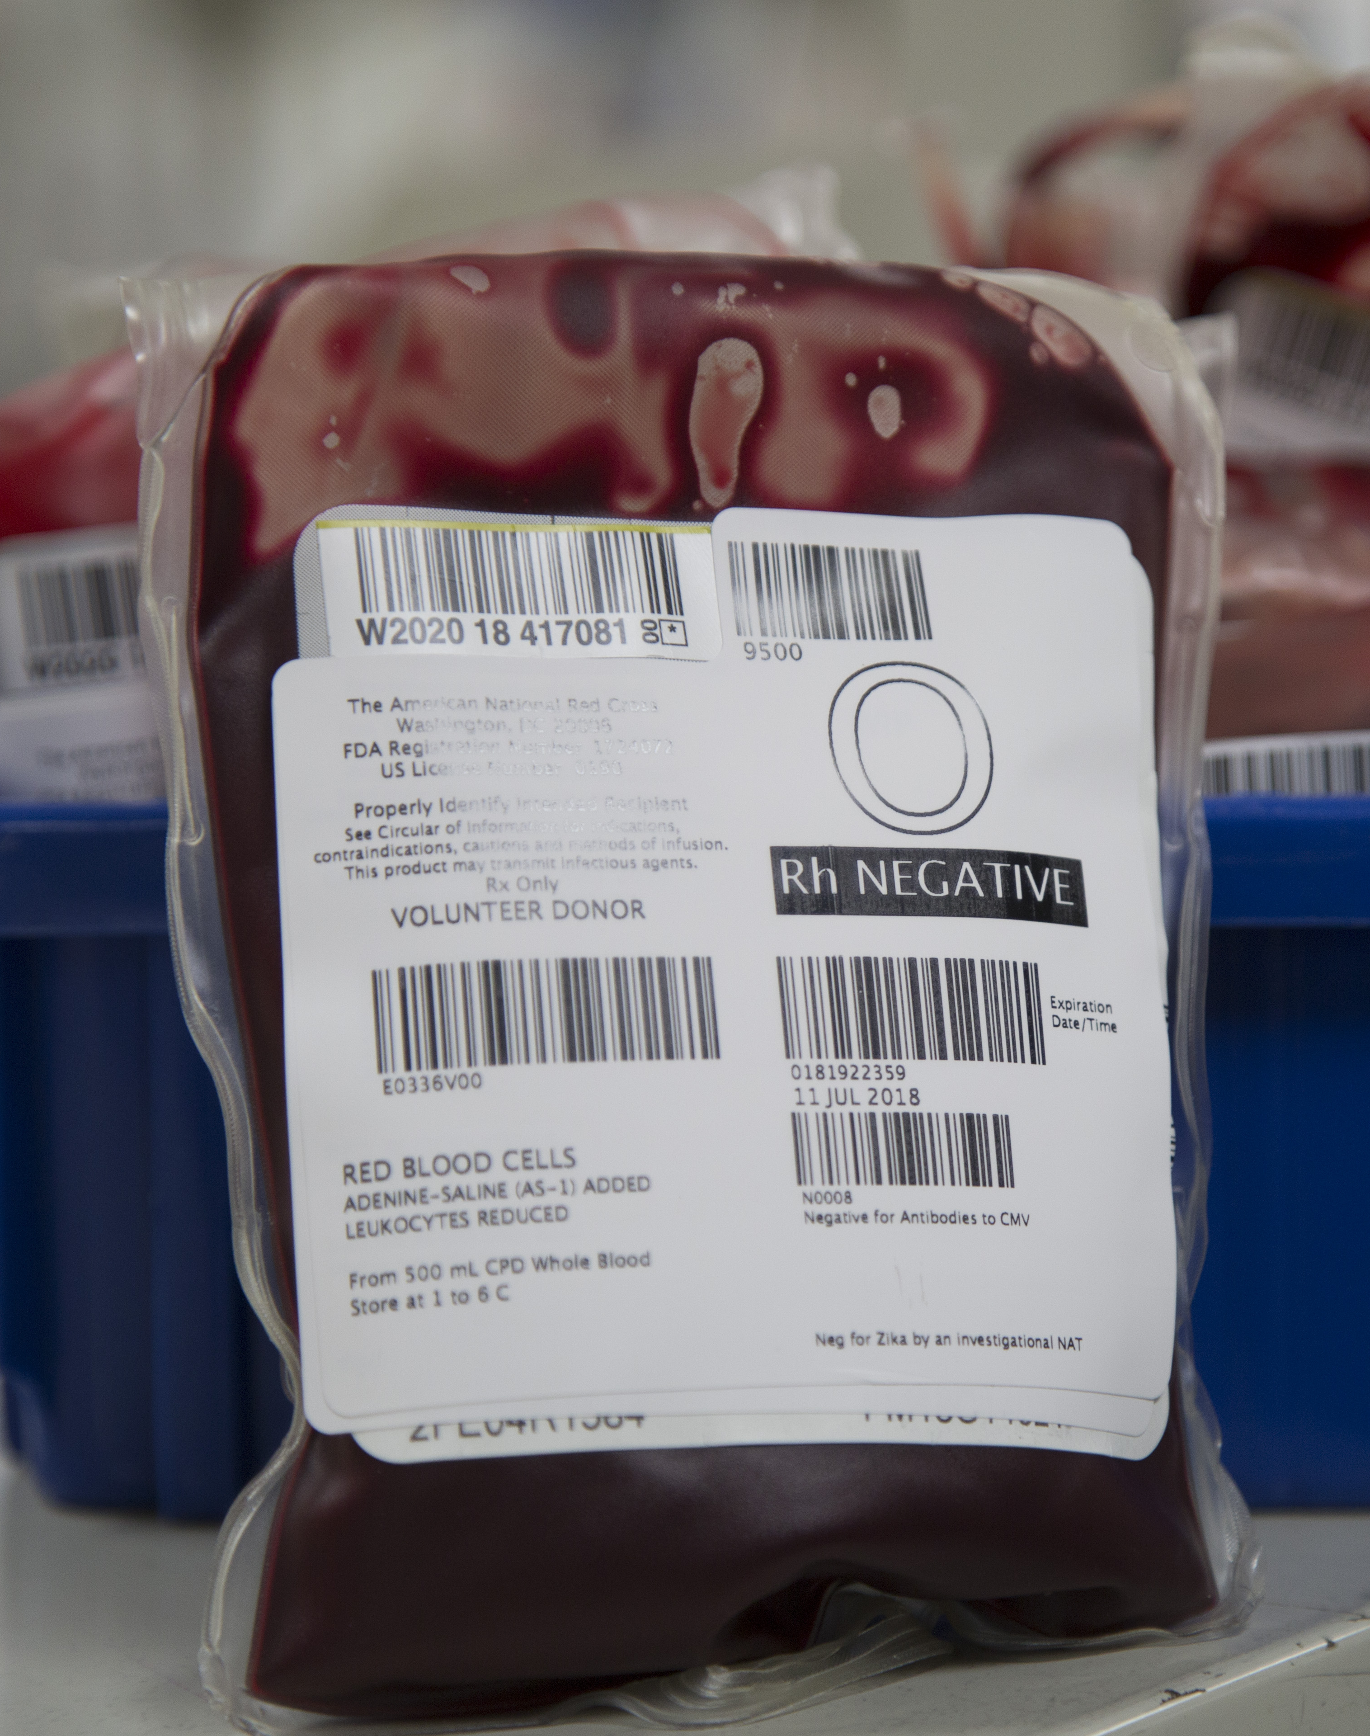
How to Perform an O Negative Audit
Start by evaluating all O negative units transfused to non-O negative patients during a defined timeframe that makes sense for your hospital.
How many units were transfused to non-O negative recipients?
Were there any situations where another type could have been used?
Notes:
If your computer system can generate O negative reports, you may be able to evaluate many or all of your O neg transfusions to find out where your O negs are going. If the audit needs to be performed manually, select a time period that makes sense and is reasonable, and consider repeating the audit periodically.

Slide 11
Common O Negative Audit Findings
O Negative Transfusions | Potential Intervention
Emergency/MTP: Female of childbearing potential with unknown blood type | None needed
Routine: O Negative patient, Rh negative patient when ABO type not available | None needed
Emergency/MTP: Male or female beyond childbearing potential with unknown blood type | Does your hospital have SOPs that allow use of O positive for these patients? If so, are staff on all shifts familiar with the policies? Sample SOPs are available by request
Routine: Non-O Negative patient, unit nearing expiration | O Negative par level/inventory level may be set too high: consider gradually reducing O negative orders and monitoring
Routine: Non-O negative patient, clinical physician required O negative unit | Physician education is needed. We can help provide journal articles, AABB best practice guidelines, or educational presentations by request
Notes:
There are several audit findings that are common between hospitals. Units used for O neg patients or FCP during emergencies when blood type is unknown are appropriate and no further action is needed. The table lists potential strategies for different audit findings. Where else might O negs be going in your hospital?

Slide 12
O Negative Tip: Know Where Your Os Go
O negative audits are a great way to better understand utilization patterns and identify potential ways to reduce O negative rates
Low O negative expiration rates do not tell the whole story
Short-dated O negative units that are routinely transfused to non-O negative patients to avoid expiration are an important source of wastage—and a potential opportunity to reduce O negative utilization
Cycle of Overutilization
Give extra O negative to non-O negative patients
Low wastage
Keep current par level
Optimizing O-negative RBC utilization using a data-driven approach. Transfusion. 60:4. Apr 2020: 739-746.
Hirani R, Wong J, Diaz P, et al. A national review of the clinical use of group O D– red blood cell units. Transfusion 2017;57:1254-61.

Slide 13
Examining O Negative Overuse
Recent studies indicate a shortage of O negative blood product, stems from significant overuse when the type was not required for transfusion.
67%
In this study, the authors found that 67% of their O negative units were transfused to non-O negative recipients
Notes:
Stanford experience
67% O negative units transfused to non-O negative recipients,
O negative units at end of shelf life more likely to be transfused to non-O negative patients to prevent wastage
This study is an excellent example of how an audit can help you to find ways to reduce O neg overutilization. The authors found that two-thirds of their O negative units were being transfused to non-O negative recipients. They were able to drill down and find out more about where their Os were going, and this helped them to reduce their O negative rates without impacting their O negative patients. More detail on the next slide…

Slide 14
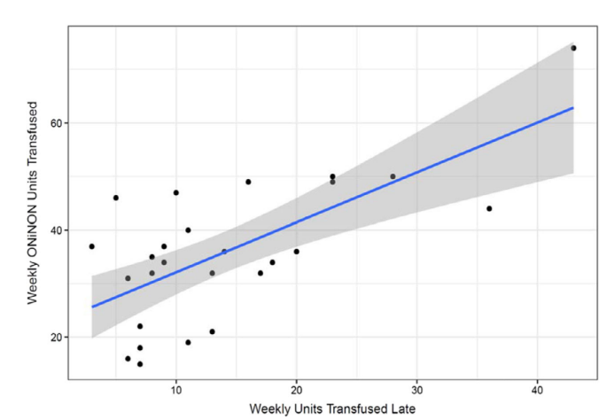
Additional Optimus Study Findings
The study found that shorter dated O negative units were more likely to be given to non-O negative recipients.
Number of units transfused later in shelf-life correlated with inappropriate O negative RBC usage (O negative into Non-O negative patients = ONiNON)
Gradually reducing O negative inventory levels successfully reduced late and inappropriate O negative transfusions
O negative patients were not impacted
No increase in ad-hoc O negative orders
Notes:
The study found that shorter dated O Negative units were more likely to be given to non-O Negative recipients, and focusing their audit on shorter dated O Negative units helped them to more easily identify inappropriate usage. Additionally, they were able to gradually reduce their O Negative inventory level while continuing to monitor the decline in short dated O Negative units given to non-O neg patients, and they did not see any impact on their O negative patients: they did not have an increase in stat ad hoc orders for O negative patients when they gradually reduced their inventory levels. This is really important, because we do not want to impact O negative patients—in fact the entire purpose of the Empower Group O initiative is to help to help stabilize the O Negative supply to ensure it is available for the patients who need it most! We only want to reduce the O Negative units that are being overutilized.

Slide 15
O Negative Transfers
Short date transfers can be another source of wastage.
Transferring short-dated units to a hospital partner that is more likely to be able to use them may be a good stewardship practice in some cases
High transfer rates may also contribute to high wastage rates at the transfer partner if they can’t be used for O negative patients
Transfers should not be considered a substitute for right-sizing O negative inventory
Expand your audit to include O negative transfers and whether they were transfused to O negative patients at the receiving hospital
Notes:
Short date transfers can be an important source of wastage. If the transferring hospital is ordering more O Neg than they need, but don’t consider it “wastage” because they are “helping” their transfer partner get more O Negs, they need to understand that many times short date transfers end up being used for non-O Neg patients at the transfer partner to avoid expiration. Some transfer partners have reported to us that 50% or more of the short date transfers they receive can’t be used for O Neg patients. This contributes to overutilization.
For hospitals that transfer a high number of short date O Negs: try gradually reducing O Neg inventory level/par level to more closely match the number of O Neg units transfused at your own facility. This will reduce the number of units that become short date and need to be transferred. For hospitals that accept transfers but find many go to non-O Neg patients to avoid expiration, particularly if this happens consistently, try gradually reducing order levels for O Neg RBCs to account for the transfers received and/or work with the transfer partner to reduce the number of short date O Negs they are transferring. We can help to support these conversations.

Slide 16
Facts in Review
O negative population in the U.S is 6.9% and declining
Fewer people donate blood today than in the past
An estimated 85% of all hospital patients are Rh positive
Most trauma patients are male
Less than 5% of patients with Sickle Cell disease are O negative
As most patients are Rh positive, the overall risk of anti-D alloimmunization is 3 – 6% when using O positive for emergencies
A transfusion should never be withheld from a bleeding patient
We must work together to reduce our reliance on O negative blood and safely use O positive blood for emergency transfusions.
Notes:
When reviewing the facts, it is clear must act now to protect the blood supply of the future.
O negative blood is in chronic short supply.
O negative inventory remains low and unstable despite robust collections.
Changing demographics and donor populations will further challenge stable O negative supplies.
Studies indicate O negative shortages stems from significant overuse when O negative blood was not required for transfusion.
Demand for O negative blood continues to rise as it is operationally more convenient, but not medically required.
Patient care, especially for those that require O negative blood is adversely impacted by inconsistencies in supply.
Without action, O negative shortages and their impact on patient care will only worsen.

Slide 17
Additional resources can be found at: RedCrossBlood.org/HPRG

